Slide 1



FPT Software
ANDROID TRAINING
LESSON 9
Version 0.1

Slide 2
Agenda
Content Provider Basics
Accessing a Content Provider
Developing a Custom Content Provider
2/11/2012
Android Insights - 3
<number>/18

Slide 3
Content Provider
A content provider manages access to a central repository of data.
The provider is part of an Android application, which often provides its own UI for working with the data.
However, content providers are primarily intended to be used by other applications, which access the provider using a provider client object.
Together, providers and provider clients offer a consistent, standard interface to data that also handles inter-process communication and secure data access.
2/11/2012
Android Insights - 3
<number>/18

Slide 4
Accessing a Content Provider
A content provider offers methods which correspond to the basic CRUD functions of persistent storage.
An application accesses the data from a content provider with a ContentResolver client object. This object has methods that call identically-named methods in the provider object.
A content provider is identified by a content URI.
2/11/2012
Android Insights - 3
<number>/18

Slide 5
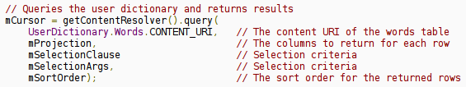
Accessing a Content Provider
Example of getting a list of words from the User Dictionary provider:
The content URI of the words table is: content://user_dictionary/words
Read permission for accessing the content provider is also needed in the manifest file:
2/11/2012
Android Insights - 3
<number>/18

Slide 6
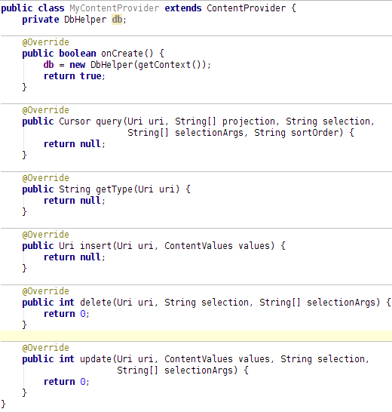
Developing a Custom
Content Provider
Extend the ContentProvider class.
In the onCreate() method, create a new instance of the database helper class.
2/11/2012
Android Insights - 3
<number>/18

Slide 7
Developing a Custom
Content Provider
Suppose, we need to provide access to 2 tables through this single content provider. As we have only one method per CRUD operation, we need a way to differentiate between accesses to these two tables.
We need to define content URI paths to each table. These are defined in a public final class which can be used by both provider and user as a contract: (see next slide)
2/11/2012
Android Insights - 3
<number>/18

Slide 8
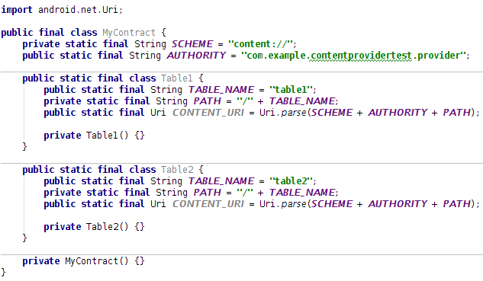
Developing a Custom
Content Provider
2/11/2012
Android Insights - 3
<number>/18

Slide 9
Developing a Custom
Content Provider
Now comes the issue of differentiating between paths. The idea is to match a URI and then taking appropriate actions for the corresponding table path.
Add a UriMatcher to the provider and add expected URI patterns to it.
In the query() method, get the appropriate table name from the URI.
2/11/2012
Android Insights - 3
<number>/18

Slide 10
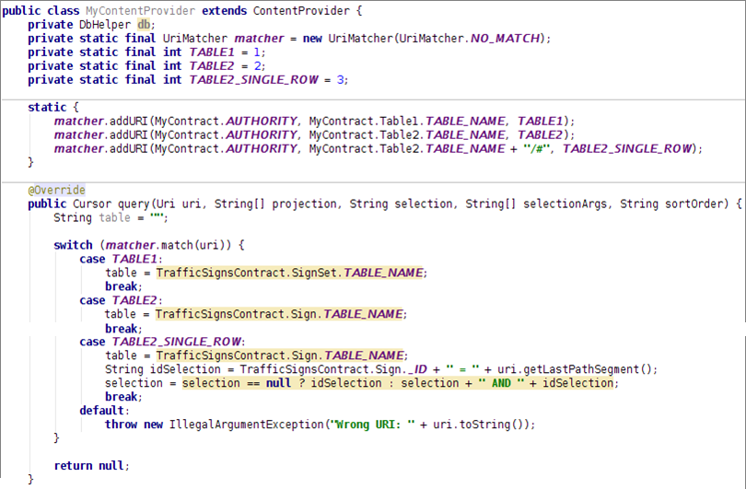
Developing a Custom
Content Provider
2/11/2012
Android Insights - 3
<number>/18

Slide 11
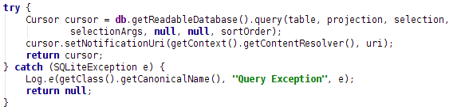
Developing a Custom
Content Provider
Now write the actual query method:
You should add this URI to notification observables by calling setNotificationUri()so that if this cursor is directly used in a ListView, updating or inserting or deleting data in the table represented by this URI would notify the ListView of this data change.
2/11/2012
Android Insights - 3
<number>/18

Slide 12
Developing a Custom
Content Provider
insert, update and delete methods are similar.
  insert() returns the Uri with the newly inserted ID appended.
  update() and delete() returns the number of rows affected.
  You should call notifyChangeToContentObservers(uri); before returning from these methods.
2/11/2012
Android Insights - 3
<number>/18

Slide 13
Developing a Custom
Content Provider
We need to provide MIME type of the data returned by a URI.
The overridden method getType(Uri uri) needs to be filled-in.
  For common types of data such as as text, HTML, or JPEG, getType() should return the standard MIME type for that data.
  For content URIs that point to a row or rows of table data, getType() should return a MIME type in Android's vendor-specific MIME format:
    Type part: vnd
    Subtype part:
      If the URI pattern is for a single row: vnd.android.cursor.item/
      If the URI pattern is for more than one row: vnd.android.cursor.dir/
    Provider-specific part: vnd.<name>.<type>
      You supply the <name> and <type>.
      The <name> value should be globally unique, and the <type> value should be unique to the corresponding URI pattern.
      A good choice for <name> is your company's name or some part of your application's Android package name.
      A good choice for the <type> is a string that identifies the table associated with the URI.
2/11/2012
Android Insights - 3
<number>/18

Slide 14
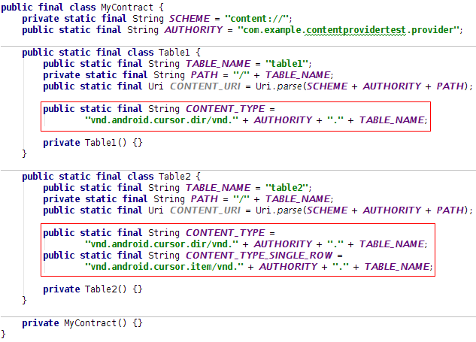
Developing a Custom
Content Provider
Content type defined in the contract class:
2/11/2012
Android Insights - 3
<number>/18

Slide 15
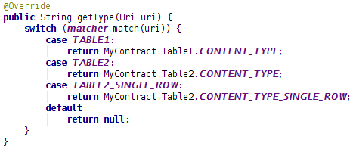
Developing a Custom
Content Provider
getType() method in the provider class:
2/11/2012
Android Insights - 3
<number>/18

Slide 16
Developing a Custom
Content Provider
We need to declare the provider in the manifest.xml file:
2/11/2012
Android Insights - 3
<number>/18

Slide 17
Developing a Custom
Content Provider
Finally, we need to define permissions for applications who wish to access the provider.
Different forms of permissions:
Single read-write provider-level permission
  One permission that controls both read and write access to the entire provider, specified with the android:permission attribute of the <provider> element in manifest.xml.
Separate read and write provider-level permission
  A read permission and a write permission for the entire provider.
  Specified with the android:readPermission and android:writePermission attributes of the <provider> element.
  They take precedence over the permission required by android:permission.
Path-level permission
  Read, write, or read/write permission for a content URI in your provider.
  You specify each URI you want to control with a <path-permission> child element of the <provider> element.
Temporary permission
  A permission level that grants temporary access to an application, even if the application doesn't have the permissions that are normally required.
2/11/2012
Android Insights - 3
<number>/18

Slide 18
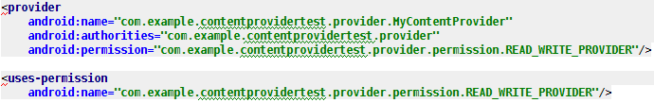
Developing a Custom
Content Provider
Permission defined in manifest.xml of the provider:
Permission defined in manifest.xml of the user:
2/11/2012
Android Insights - 3
<number>/18

Slide 19
Homework
Add content provider for Employee Project

Slide 20
Thank you!

